Slide 1
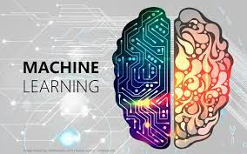
MACHINE LEARNING

Slide 2
ROADMAP
What is Machine Learning? What problems does it try to solve? What are the
main categories and fundamental concepts of Machine Learning systems?
• The main steps in a typical Machine Learning project.
• Learning by fitting a model to data.
• Optimizing a cost function.
• Handling, cleaning, and preparing data.
• Selecting and engineering features.
• Selecting a model and tuning hyperparameters using cross-validation.
• The main challenges of Machine Learning, in particular underfitting and overfit‐
ting (the bias/variance tradeoff).
• Reducing the dimensionality of the training data to fight the curse of dimension‐
ality.
• Other unsupervised learning techniques, including clustering, density estimation
and anomaly detection.
• The most common learning algorithms: Linear and Polynomial Regression,
Logistic Regression, k-Nearest Neighbors, Support Vector Machines, Decision
Trees, Random Forests, and Ensemble methods.

Slide 3
What Is Machine Learning?
Machine Learning is the science (and art) of programming computers so they can
learn from data.
Here is a slightly more general definition:
[Machine Learning is the] field of study that gives computers the ability to learn
without being explicitly programmed.
—Arthur Samuel, 1959
And a more engineering-oriented one:
A computer program is said to learn from experience E with respect to some task T
and some performance measure P, if its performance on T, as measured by P, improves
with experience E.
—Tom Mitchell, 1997
For example, your spam filter is a Machine Learning program that can learn to flag
spam given examples of spam emails (e.g., flagged by users) and examples of regular
(nonspam, also called “ham”) emails. The examples that the system uses to learn are
called the training set. Each training example is called a training instance (or sample).
In this case, the task T is to flag spam for new emails, the experience E is the training
data, and the performance measure P needs to be defined; for example, you can use
the ratio of correctly classified emails. This particular performance measure is called
accuracy and it is often used in classification tasks.

Slide 4
Why Use Machine Learning?
1. First you would look at what spam typically looks like. You might notice that
some words or phrases (such as “4U,” “credit card,” “free,” and “amazing”) tend to
come up a lot in the subject. Perhaps you would also notice a few other patterns
in the sender’s name, the email’s body, and so on.
2. You would write a detection algorithm for each of the patterns that you noticed,
and your program would flag emails as spam if a number of these patterns are
detected.
3. You would test your program, and repeat steps 1 and 2 until it is good enough.

Slide 5
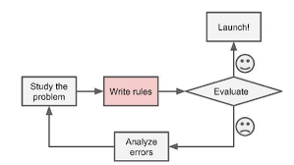

Slide 6
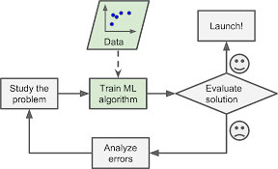
Since the problem is not trivial, your program will likely become a long list of com‐
plex rules—pretty hard to maintain.
In contrast, a spam filter based on Machine Learning techniques automatically learns
which words and phrases are good predictors of spam by detecting unusually fre‐
quent patterns of words in the spam examples compared to the ham examples
The program is much shorter, easier to maintain, and most likely more
accurate.

Slide 7
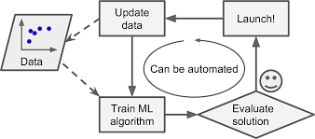
Moreover, if spammers notice that all their emails containing “4U” are blocked, they
might start writing “For U” instead. A spam filter using traditional programming
techniques would need to be updated to flag “For U” emails. If spammers keep work‐
ing around your spam filter, you will need to keep writing new rules forever.
In contrast, a spam filter based on Machine Learning techniques automatically noti‐
ces that “For U” has become unusually frequent in spam flagged by users, and it starts
flagging them without your intervention

Slide 8
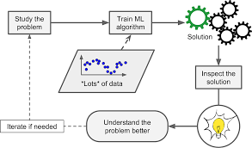
Another area where Machine Learning shines is for problems that either are too com‐
plex for traditional approaches or have no known algorithm. For example, consider
speech recognition: say you want to start simple and write a program capable of dis‐
tinguishing the words “one” and “two.” You might notice that the word “two” starts
with a high-pitch sound (“T”), so you could hardcode an algorithm that measures
high-pitch sound intensity and use that to distinguish ones and twos. Obviously this
technique will not scale to thousands of words spoken by millions of very different
people in noisy environments and in dozens of languages. The best solution (at least
today) is to write an algorithm that learns by itself, given many example recordings
for each word.
Finally, Machine Learning can help humans learn : ML algorithms can be
inspected to see what they have learned (although for some algorithms this can be
tricky). For instance, once the spam filter has been trained on enough spam, it can
easily be inspected to reveal the list of words and combinations of words that it
believes are the best predictors of spam. Sometimes this will reveal unsuspected cor‐
relations or new trends, and thereby lead to a better understanding of the problem.
Applying ML techniques to dig into large amounts of data can help discover patterns
that were not immediately apparent. This is called data mining.

Slide 9
To summarize, Machine Learning is great for:
• Problems for which existing solutions require a lot of hand-tuning or long lists of
rules: one Machine Learning algorithm can often simplify code and perform bet‐
ter.
• Complex problems for which there is no good solution at all using a traditional
approach: the best Machine Learning techniques can find a solution.
• Fluctuating environments: a Machine Learning system can adapt to new data.
• Getting insights about complex problems and large amounts of data.

Slide 10
Types of Machine Learning Systems
There are so many different types of Machine Learning systems that it is useful to
classify them in broad categories based on:
• Whether or not they are trained with human supervision (supervised, unsuper‐
vised, semisupervised, and Reinforcement Learning)
• Whether or not they can learn incrementally on the fly (online versus batch
learning)
• Whether they work by simply comparing new data points to known data points,
or instead detect patterns in the training data and build a predictive model, much
like scientists do (instance-based versus model-based learning)
These criteria are not exclusive; you can combine them in any way you like. For
example, a state-of-the-art spam filter may learn on the fly using a deep neural net‐
work model trained using examples of spam and ham; this makes it an online, model-
based, supervised learning system.
Let’s look at each of these criteria a bit more closely.

Slide 11
Supervised/Unsupervised Learning
Machine Learning systems can be classified according to the amount and type of
supervision they get during training. There are four major categories: supervised
learning, unsupervised learning, semisupervised learning, and Reinforcement Learn‐ing.

Slide 12
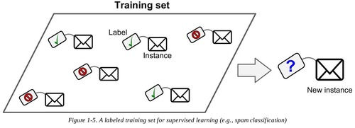
Supervised learning
In supervised learning, the training data you feed to the algorithm includes the desired
solutions, called labels .

Slide 13
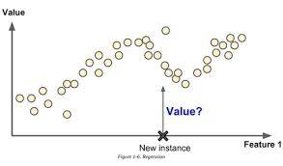
A typical supervised learning task is classification. The spam filter is a good example
of this: it is trained with many example emails along with their class (spam or ham),
and it must learn how to classify new emails.
Another typical task is to predict a target numeric value, such as the price of a car,
given a set of features (mileage, age, brand, etc.) called predictors. This sort of task is
called regression (Figure 1-6).1 To train the system, you need to give it many examples
of cars, including both their predictors and their labels (i.e., their prices).
In Machine Learning an attribute is a data type (e.g., “Mileage”),
while a feature has several meanings depending on the context, but
generally means an attribute plus its value (e.g., “Mileage =
15,000”). Many people use the words attribute and feature inter‐
changeably, though.

Slide 14
Note that some regression algorithms can be used for classification as well, and vice
versa. For example, Logistic Regression is commonly used for classification, as it can
output a value that corresponds to the probability of belonging to a given class (e.g.,
20% chance of being spam).
Here are some of the most important supervised learning algorithms :
• k-Nearest Neighbors
• Linear Regression
• Logistic Regression
• Support Vector Machines (SVMs)
• Decision Trees and Random Forests
• Neural networks

Slide 15
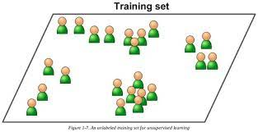
Unsupervised learning
In unsupervised learning, as you might guess, the training data is unlabeled.
The system tries to learn without a teacher

Slide 16
Here are some of the most important unsupervised learning algorithms
• Clustering
—K-Means
—DBSCAN
— Hierarchical Cluster Analysis (HCA)
• Anomaly detection and novelty detection
—One-class SVM
— Isolation Forest
• Visualization and dimensionality reduction
— Principal Component Analysis (PCA)
—Kernel PCA
— Locally-Linear Embedding (LLE)
— t-distributed Stochastic Neighbor Embedding (t-SNE)
• Association rule learning
—Apriori
— Eclat

Slide 17
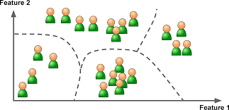
For example, say you have a lot of data about your blog’s visitors. You may want to
run a clustering algorithm to try to detect groups of similar visitors . At
no point do you tell the algorithm which group a visitor belongs to: it finds those
connections without your help. For example, it might notice that 40% of your visitors
are males who love comic books and generally read your blog in the evening, while
20% are young sci-fi lovers who visit during the weekends, and so on. If you use a
hierarchical clustering algorithm, it may also subdivide each group into smaller
groups. This may help you target your posts for each group.

Slide 18
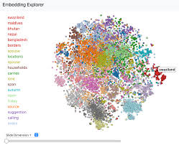
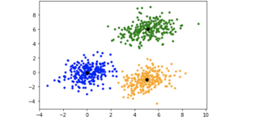
Visualization algorithms are also good examples of unsupervised learning algorithms:
you feed them a lot of complex and unlabeled data, and they output a 2D or 3D rep‐
resentation of your data that can easily be plotted . These algorithms try
to preserve as much structure as they can (e.g., trying to keep separate clusters in the
input space from overlapping in the visualization), so you can understand how the
data is organized and perhaps identify unsuspected patterns.

Slide 19
A related task is dimensionality reduction, in which the goal is to simplify the data
without losing too much information. One way to do this is to merge several correla‐
ted features into one. For example, a car’s mileage may be very correlated with its age,
so the dimensionality reduction algorithm will merge them into one feature that rep‐
resents the car’s wear and tear. This is called feature extraction.
It is often a good idea to try to reduce the dimension of your train‐
ing data using a dimensionality reduction algorithm before you
feed it to another Machine Learning algorithm (such as a super‐
vised learning algorithm). It will run much faster, the data will take
up less disk and memory space, and in some cases it may also per‐
form better.
Yet another important unsupervised task is anomaly detection—for example, detect‐
ing unusual credit card transactions to prevent fraud, catching manufacturing defects,
or automatically removing outliers from a dataset before feeding it to another learn‐
ing algorithm. The system is shown mostly normal instances during training, so it
learns to recognize them and when it sees a new instance it can tell whether it looks

Slide 20
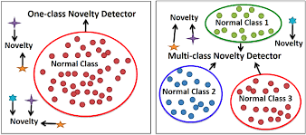
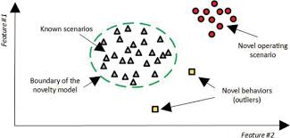
like a normal one or whether it is likely an anomaly . A very similar
task is novelty detection: the difference is that novelty detection algorithms expect to
see only normal data during training, while anomaly detection algorithms are usually
more tolerant, they can often perform well even with a small percentage of outliers in
the training set.

Slide 21
Finally, another common unsupervised task is association rule learning, in which the
goal is to dig into large amounts of data and discover interesting relations between
attributes. For example, suppose you own a supermarket. Running an association rule
on your sales logs may reveal that people who purchase barbecue sauce and potato
chips also tend to buy steak. Thus, you may want to place these items close to each
other.
Semisupervised learning
Some algorithms can deal with partially labeled training data, usually a lot of unla‐
beled data and a little bit of labeled data. This is called semisupervised learning.
Some photo-hosting services, such as Google Photos, are good examples of this. Once
you upload all your family photos to the service, it automatically recognizes that the
same person A shows up in photos 1, 5, and 11, while another person B shows up in
photos 2, 5, and 7. This is the unsupervised part of the algorithm (clustering). Now all
the system needs is for you to tell it who these people are. Just one label per person,4
and it is able to name everyone in every photo, which is useful for searching photos

Slide 22
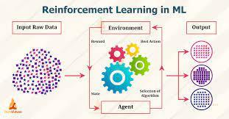
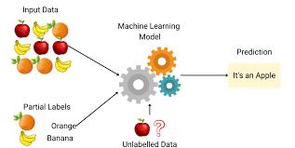
Most semisupervised learning
algorithms are combinations of unsupervised and supervised algorithms. For example, deep belief networks (DBNs) are based on unsu‐pervised components called restricted Boltzmann machines (RBMs) stacked on top of one another. RBMs are trained sequentially in an unsupervised manner, and then the whole system is fine-tuned using supervised learning techniques.
Reinforcement Learning
Reinforcement Learning is a very different beast. The learning system, called an agent
in this context, can observe the environment, select and perform actions, and get
rewards in return (or penalties in the form of negative rewards, as in Figure . It
must then learn by itself what is the best strategy, called a policy, to get the most
reward over time. A policy defines what action the agent should choose when it is in a
given situation.

Slide 23
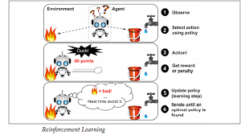
For example, many robots implement Reinforcement Learning algorithms to learn
how to walk. DeepMind’s AlphaGo program is also a good example of Reinforcement
Learning: it made the headlines in May 2017 when it beat the world champion Ke Jie
at the game of Go. It learned its winning policy by analyzing millions of games, and
then playing many games against itself. Note that learning was turned off during the
games against the champion; AlphaGo was just applying the policy it had learned.

Slide 24
Batch and Online Learning
Another criterion used to classify Machine Learning systems is whether or not the
system can learn incrementally from a stream of incoming data.
Batch learning
In batch learning, the system is incapable of learning incrementally: it must be trained
using all the available data. This will generally take a lot of time and computing
resources, so it is typically done offline. First the system is trained, and then it is
launched into production and runs without learning anymore; it just applies what it
has learned. This is called offline learning.
If you want a batch learning system to know about new data (such as a new type of
spam), you need to train a new version of the system from scratch on the full dataset
(not just the new data, but also the old data), then stop the old system and replace it
with the new one.
Fortunately, the whole process of training, evaluating, and launching a Machine
Learning system can be automated fairly easily , so even a

Slide 25
batch learning system can adapt to change. Simply update the data and train a new
version of the system from scratch as often as needed.
This solution is simple and often works fine, but training using the full set of data can
take many hours, so you would typically train a new system only every 24 hours or
even just weekly. If your system needs to adapt to rapidly changing data (e.g., to pre‐
dict stock prices), then you need a more reactive solution.
Also, training on the full set of data requires a lot of computing resources (CPU,
memory space, disk space, disk I/O, network I/O, etc.). If you have a lot of data and
you automate your system to train from scratch every day, it will end up costing you a
lot of money. If the amount of data is huge, it may even be impossible to use a batch
learning algorithm.
Finally, if your system needs to be able to learn autonomously and it has limited
resources (e.g., a smartphone application or a rover on Mars), then carrying around
large amounts of training data and taking up a lot of resources to train for hours
every day is a showstopper.
Fortunately, a better option in all these cases is to use algorithms that are capable of
learning incrementally.
Online learning
In online learning, you train the system incrementally by feeding it data instances
sequentially, either individually or by small groups called mini-batches. Each learning
step is fast and cheap, so the system can learn about new data on the fly, as it arrives.

Slide 26
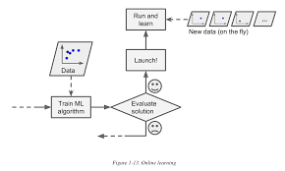
Online learning is great for systems that receive data as a continuous flow (e.g., stock
prices) and need to adapt to change rapidly or autonomously. It is also a good option if you have limited computing resources: once an online learning system has learned
about new data instances, it does not need them anymore, so you can discard them
(unless you want to be able to roll back to a previous state and “replay” the data). This
can save a huge amount of space.
Online learning algorithms can also be used to train systems on huge datasets that
cannot fit in one machine’s main memory (this is called out-of-core learning). The
algorithm loads part of the data, runs a training step on that data, and repeats the
process until it has run on all of the data (see Figure 1-14).
Out-of-core learning is usually done offline (i.e., not on the live
system), so online learning can be a confusing name. Think of it as
incremental learning.

Slide 27
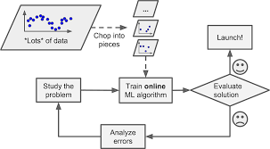
One important parameter of online learning systems is how fast they should adapt to
changing data: this is called the learning rate. If you set a high learning rate, then your
system will rapidly adapt to new data, but it will also tend to quickly forget the old
data (you don’t want a spam filter to flag only the latest kinds of spam it was shown).
Conversely, if you set a low learning rate, the system will have more inertia; that is, it
will learn more slowly, but it will also be less sensitive to noise in the new data or to
sequences of nonrepresentative data points (outliers).
A big challenge with online learning is that if bad data is fed to the system, the sys‐
tem’s performance will gradually decline. If we are talking about a live system, your
clients will notice. For example, bad data could come from a malfunctioning sensor
on a robot, or from someone spamming a search engine to try to rank high in search results. To reduce this risk, you need to monitor your system closely and promptly
switch learning off (and possibly revert to a previously working state) if you detect a
drop in performance. You may also want to monitor the input data and react to
abnormal data (e.g., using an anomaly detection algorithm)

Slide 28
Instance-Based Versus Model-Based Learning
One more way to categorize Machine Learning systems is by how they generalize.
Most Machine Learning tasks are about making predictions. This means that given a
number of training examples, the system needs to be able to generalize to examples it
has never seen before. Having a good performance measure on the training data is
good, but insufficient; the true goal is to perform well on new instances.
There are two main approaches to generalization: instance-based learning and
model-based learning.
Instance-based learning
Possibly the most trivial form of learning is simply to learn by heart. If you were to
create a spam filter this way, it would just flag all emails that are identical to emails
that have already been flagged by users—not the worst solution, but certainly not the
best.
Instead of just flagging emails that are identical to known spam emails, your spam
filter could be programmed to also flag emails that are very similar to known spam
emails. This requires a measure of similarity between two emails. A (very basic) simi‐
larity measure between two emails could be to count the number of words they have
in common. The system would flag an email as spam if it has many words in com‐
mon with a known spam email.
This is called instance-based learning: the system learns the examples by heart, then
generalizes to new cases by comparing them to the learned examples (or a subset of
them), using a similarity measure. For example, in Figure 1-15 the new instance
would be classified as a triangle because the majority of the most similar instances
belong to that class.

Slide 29
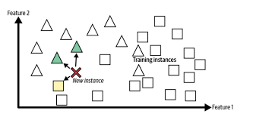
Model-based learning
Another way to generalize from a set of examples is to build a model of these exam‐ples, then use that model to make predictions. This is called model-based learning.

Slide 30
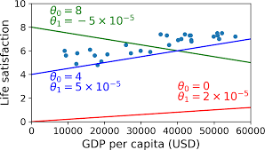
Before you can use your model, you need to define the parameter values θ0
and θ1
.
How can you know which values will make your model perform best? To answer this
question, you need to specify a performance measure. You can either define a utility
function (or fitness function) that measures how good your model is, or you can define
a cost function that measures how bad it is. For linear regression problems, people
typically use a cost function that measures the distance between the linear model’s
predictions and the training examples; the objective is to minimize this distance.
This is where the Linear Regression algorithm comes in: you feed it your training
examples and it finds the parameters that make the linear model fit best to your data.
This is called training the model. In our case the algorithm finds that the optimal
parameter values are θ0
= 4.85 and θ1
= 4.91 × 10–5
.

Slide 31
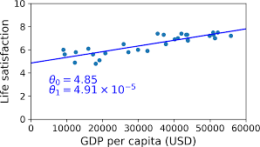
Now the model fits the training data as closely as possible (for a linear model).

Slide 32
Main Challenges of Machine Learning
In short, since your main task is to select a learning algorithm and train it on some
data, the two things that can go wrong are “bad algorithm” and “bad data.” Let’s start
with examples of bad data.
Insufficient Quantity of Training Data
For a toddler to learn what an apple is, all it takes is for you to point to an apple and
say “apple” (possibly repeating this procedure a few times). Now the child is able to
recognize apples in all sorts of colors and shapes. Genius.
Machine Learning is not quite there yet; it takes a lot of data for most Machine Learn‐
ing algorithms to work properly. Even for very simple problems you typically need
thousands of examples, and for complex problems such as image or speech recogni‐
tion you may need millions of examples (unless you can reuse parts of an existing
model).

Slide 33
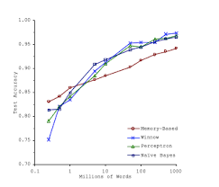
he Unreasonable Effectiveness of Data
In a famous paper published in 2001, Microsoft researchers Michele Banko and Eric
Brill showed that very different Machine Learning algorithms, including fairly simple
ones, performed almost identically well on a complex problem of natural language
disambiguation8 once they were given enough data The importance of data versus algorithms9
As the authors put it: “these results suggest that we may want to reconsider the trade-
off between spending time and money on algorithm development versus spending it
on corpus development.”
The idea that data matters more than algorithms for complex problems was further
popularized by Peter Norvig et al. in a paper titled “The Unreasonable Effectiveness
of Data” published in 2009.10
It should be noted, however, that small- and medium-
sized datasets are still very common, and it is not always easy or cheap to get extra
training data, so don’t abandon algorithms just yet.

Slide 34
Nonrepresentative Training Data
In order to generalize well, it is crucial that your training data be representative of the
new cases you want to generalize to. This is true whether you use instance-based
learning or model-based learning.
For example, the set of countries we used earlier for training the linear model was not
perfectly representative; a few countries were missing. A more representative training sample
If you train a linear model on this data, you get the solid line, while the old model is
represented by the dotted line. As you can see, not only does adding a few missing
countries significantly alter the model, but it makes it clear that such a simple linear
model is probably never going to work well. It seems that very rich countries are not
happier than moderately rich countries (in fact they seem unhappier), and conversely
some poor countries seem happier than many rich countries.
By using a nonrepresentative training set, we trained a model that is unlikely to make
accurate predictions, especially for very poor and very rich countries.
It is crucial to use a training set that is representative of the cases you want to general‐
ize to. This is often harder than it sounds: if the sample is too small, you will have
sampling noise (i.e., nonrepresentative data as a result of chance), but even very large
samples can be nonrepresentative if the sampling method is flawed. This is called
sampling bias.

Slide 35
Instead, Roosevelt won with 62% of the votes. The flaw was in the Literary Digest’s
sampling method:
• First, to obtain the addresses to send the polls to, the Literary Digest used tele‐
phone directories, lists of magazine subscribers, club membership lists, and the
like. All of these lists tend to favor wealthier people, who are more likely to vote
Republican (hence Landon).
• Second, less than 25% of the people who received the poll answered. Again, this
introduces a sampling bias, by ruling out people who don’t care much about poli‐
tics, people who don’t like the Literary Digest, and other key groups. This is a spe‐
cial type of sampling bias called nonresponse bias.
Here is another example: say you want to build a system to recognize funk music vid‐
eos. One way to build your training set is to search “funk music” on YouTube and use
the resulting videos. But this assumes that YouTube’s search engine returns a set of
videos that are representative of all the funk music videos on YouTube. In reality, the
search results are likely to be biased toward popular artists (and if you live in Brazil
you will get a lot of “funk carioca” videos, which sound nothing like James Brown).
On the other hand, how else can you get a large training set?
Poor-Quality Data
Obviously, if your training data is full of errors, outliers, and noise (e.g., due to poor-
quality measurements), it will make it harder for the system to detect the underlying
patterns, so your system is less likely to perform well. It is often well worth the effort
to spend time cleaning up your training data. The truth is, most data scientists spend
a significant part of their time doing just that. For example:
• If some instances are clearly outliers, it may help to simply discard them or try to
fix the errors manually.

Slide 36
• If some instances are missing a few features (e.g., 5% of your customers did not
specify their age), you must decide whether you want to ignore this attribute alto‐
gether, ignore these instances, fill in the missing values (e.g., with the median
age), or train one model with the feature and one model without it, and so on.
Irrelevant Features
As the saying goes: garbage in, garbage out. Your system will only be capable of learn‐
ing if the training data contains enough relevant features and not too many irrelevant
ones. A critical part of the success of a Machine Learning project is coming up with a
good set of features to train on. This process, called feature engineering, involves Feature selection: selecting the most useful features to train on among existing
features.
• Feature extraction: combining existing features to produce a more useful one (as
we saw earlier, dimensionality reduction algorithms can help).
• Creating new features by gathering new data.
Now that we have looked at many examples of bad data, let’s look at a couple of exam‐
ples of bad algorithms.

Slide 37
Overfitting the Training Data
Say you are visiting a foreign country and the taxi driver rips you off. You might be
tempted to say that all taxi drivers in that country are thieves. Overgeneralizing is
something that we humans do all too often, and unfortunately machines can fall into
the same trap if we are not careful. In Machine Learning this is called overfitting: it
means that the model performs well on the training data, but it does not generalize
well. Complex models such as deep neural networks can detect subtle patterns in the data,
but if the training set is noisy, or if it is too small (which introduces sampling noise),
then the model is likely to detect patterns in the noise itself. Obviously these patterns
will not generalize to new instances. For example, say you feed your life satisfaction
model many more attributes, including uninformative ones such as the country’s
name. In that case, a complex model may detect patterns like the fact that all coun‐
tries in the training data with a w in their name have a life satisfaction greater than 7:
New Zealand (7.3), Norway (7.4), Sweden (7.2), and Switzerland (7.5). How confident are you that the W-satisfaction rule generalizes to Rwanda or Zimbabwe? Obviously
this pattern occurred in the training data by pure chance, but the model has no way
to tell whether a pattern is real or simply the result of noise in the data.
Overfitting happens when the model is too complex relative to the
amount and noisiness of the training data. The possible solutions
are:
• To simplify the model by selecting one with fewer parameters
(e.g., a linear model rather than a high-degree polynomial
model), by reducing the number of attributes in the training

Slide 38
are you that the W-satisfaction rule generalizes to Rwanda or Zimbabwe? Obviously
this pattern occurred in the training data by pure chance, but the model has no way
to tell whether a pattern is real or simply the result of noise in the data.
Overfitting happens when the model is too complex relative to the
amount and noisiness of the training data. The possible solutions
are:• To simplify the model by selecting one with fewer parameters
(e.g., a linear model rather than a high-degree polynomial
model), by reducing the number of attributes in the training
data or by constraining the model
• To gather more training data
• To reduce the noise in the training data (e.g., fix data errors
and remove outliers)
Constraining a model to make it simpler and reduce the risk of overfitting is called
regularization. For example, the linear model we defined earlier has two parameters,
θ0
and θ1
. This gives the learning algorithm two degrees of freedom to adapt the model
to the training data: it can tweak both the height (θ0
we forced θ1
) and the slope (θ1
) of the line. If
= 0, the algorithm would have only one degree of freedom and would
have a much harder time fitting the data properly: all it could do is move the line up
or down to get as close as possible to the training instances, so it would end up
around the mean. A very simple model indeed! If we allow the algorithm to modify θ1

Slide 39
but we force it to keep it small, then the learning algorithm will effectively have some‐
where in between one and two degrees of freedom. It will produce a simpler model
than with two degrees of freedom, but more complex than with just one. You want to
find the right balance between fitting the training data perfectly and keeping the
model simple enough to ensure that it will generalize well.
Figure 1-23 shows three models: the dotted line represents the original model that
was trained with a few countries missing, the dashed line is our second model trained
with all countries, and the solid line is a linear model trained with the same data as
the first model but with a regularization constraint. You can see that regularization
forced the model to have a smaller slope, which fits a bit less the training data that the
model was trained on, but actually allows it to generalize better to new examples.

Slide 40
The amount of regularization to apply during learning can be controlled by a hyper‐
parameter. A hyperparameter is a parameter of a learning algorithm (not of the
model). As such, it is not affected by the learning algorithm itself; it must be set prior
to training and remains constant during training. If you set the regularization hyper‐
parameter to a very large value, you will get an almost flat model (a slope close to
zero); the learning algorithm will almost certainly not overfit the training data, but it
will be less likely to find a good solution. Tuning hyperparameters is an important
part of building a Machine Learning system (you will see a detailed example in the
next chapter).
Underfitting the Training Data
As you might guess, underfitting is the opposite of overfitting: it occurs when your
model is too simple to learn the underlying structure of the data. For example, a lin‐
ear model of life satisfaction is prone to underfit; reality is just more complex than
the model, so its predictions are bound to be inaccurate, even on the training exam‐
ples.
The main options to fix this problem are:
• Selecting a more powerful model, with more parameters
• Feeding better features to the learning algorithm (feature engineering)
• Reducing the constraints on the model (e.g., reducing the regularization hyper‐
parameter

Slide 41
Stepping Back
By now you already know a lot about Machine Learning. However, we went through
so many concepts that you may be feeling a little lost, so let’s step back and look at the
big picture • Machine Learning is about making machines get better at some task by learning
from data, instead of having to explicitly code rules.
• There are many different types of ML systems: supervised or not, batch or online,
instance-based or model-based, and so on.
• In a ML project you gather data in a training set, and you feed the training set to
a learning algorithm. If the algorithm is model-based it tunes some parameters to
fit the model to the training set (i.e., to make good predictions on the training set
itself), and then hopefully it will be able to make good predictions on new cases
as well. If the algorithm is instance-based, it just learns the examples by heart and
generalizes to new instances by comparing them to the learned instances using a
similarity measure.

Slide 42
• The system will not perform well if your training set is too small, or if the data is
not representative, noisy, or polluted with irrelevant features (garbage in, garbage
out). Lastly, your model needs to be neither too simple (in which case it will
underfit) nor too complex (in which case it will overfit).
There’s just one last important topic to cover: once you have trained a model, you
don’t want to just “hope” it generalizes to new cases. You want to evaluate it, and fine-
tune it if necessary. Let’s see how.

Slide 43
Testing and Validating
The only way to know how well a model will generalize to new cases is to actually try
it out on new cases. One way to do that is to put your model in production and moni‐
tor how well it performs. This works well, but if your model is horribly bad, your
users will complain—not the best idea.
A better option is to split your data into two sets: the training set and the test set. As
these names imply, you train your model using the training set, and you test it using
the test set. The error rate on new cases is called the generalization error (or out-of-
sample error), and by evaluating your model on the test set, you get an estimate of this
error. This value tells you how well your model will perform on instances it has never
seen before.
If the training error is low (i.e., your model makes few mistakes on the training set)
but the generalization error is high, it means that your model is overfitting the train‐
ing data.

Slide 44
Hyperparameter Tuning and Model Selection
So evaluating a model is simple enough: just use a test set. Now suppose you are hesi‐
tating between two models (say a linear model and a polynomial model): how can
you decide? One option is to train both and compare how well they generalize using
the test set.
Now suppose that the linear model generalizes better, but you want to apply some
regularization to avoid overfitting. The question is: how do you choose the value of
the regularization hyperparameter? One option is to train 100 different models using
100 different values for this hyperparameter. Suppose you find the best hyperparame‐
ter value that produces a model with the lowest generalization error, say just 5% error.
So you launch this model into production, but unfortunately it does not perform as
well as expected and produces 15% errors. What just happened?
The problem is that you measured the generalization error multiple times on the test
set, and you adapted the model and hyperparameters to produce the best model for
that particular set. This means that the model is unlikely to perform as well on new
data.

Slide 45
A common solution to this problem is called holdout validation: you simply hold out
part of the training set to evaluate several candidate models and select the best one.
The new heldout set is called the validation set (or sometimes the development set, or
dev set). More specifically, you train multiple models with various hyperparameters
on the reduced training set (i.e., the full training set minus the validation set), and
you select the model that performs best on the validation set. After this holdout vali‐
dation process, you train the best model on the full training set (including the valida‐
tion set), and this gives you the final model. Lastly, you evaluate this final model on
the test set to get an estimate of the generalization error.

Slide 46
This solution usually works quite well. However, if the validation set is too small, then
model evaluations will be imprecise: you may end up selecting a suboptimal model by
mistake. Conversely, if the validation set is too large, then the remaining training set
will be much smaller than the full training set. Why is this bad? Well, since the final
model will be trained on the full training set, it is not ideal to compare candidate
models trained on a much smaller training set. It would be like selecting the fastest
sprinter to participate in a marathon. One way to solve this problem is to perform
repeated cross-validation, using many small validation sets. Each model is evaluated
once per validation set, after it is trained on the rest of the data. By averaging out all
the evaluations of a model, we get a much more accurate measure of its performance.
However, there is a drawback: the training time is multiplied by the number of valida‐
tion sets.

Slide 47
Data Mismatch
In some cases, it is easy to get a large amount of data for training, but it is not per‐
fectly representative of the data that will be used in production. For example, suppose
you want to create a mobile app to take pictures of flowers and automatically deter‐
mine their species. You can easily download millions of pictures of flowers on the
web, but they won’t be perfectly representative of the pictures that will actually be
taken using the app on a mobile device. Perhaps you only have 10,000 representative
pictures (i.e., actually taken with the app). In this case, the most important rule to
remember is that the validation set and the test must be as representative as possible
of the data you expect to use in production, so they should be composed exclusively
of representative pictures: you can shuffle them and put half in the validation set, and
half in the test set (making sure that no duplicates or near-duplicates end up in both
sets).

Slide 48
After training your model on the web pictures, if you observe that the perfor‐
mance of your model on the validation set is disappointing, you will not know
whether this is because your model has overfit the training set, or whether this is just
due to the mismatch between the web pictures and the mobile app pictures. One sol‐
ution is to hold out part of the training pictures (from the web) in yet another set that
Andrew Ng calls the train-dev set. After the model is trained (on the training set, not
on the train-dev set), you can evaluate it on the train-dev set: if it performs well, then
the model is not overfitting the training set, so if performs poorly on the validation
set, the problem must come from the data mismatch. You can try to tackle this prob‐
lem by preprocessing the web images to make them look more like the pictures that
will be taken by the mobile app, and then retraining the model. Conversely, if the
model performs poorly on the train-dev set, then the model must have overfit the
training set, so you should try to simplify or regularize the model, get more training
data and clean up the training data, as discussed earlier.

Slide 49
No Free Lunch Theorem
A model is a simplified version of the observations. The simplifications are meant to
discard the superfluous details that are unlikely to generalize to new instances. How‐
ever, to decide what data to discard and what data to keep, you must make assump‐
tions. For example, a linear model makes the assumption that the data is
fundamentally linear and that the distance between the instances and the straight line
is just noise, which can safely be ignored.
In a famous 1996 paper,11
David Wolpert demonstrated that if you make absolutely
no assumption about the data, then there is no reason to prefer one model over any
other. This is called the No Free Lunch (NFL) theorem. For some datasets the best model is a linear model, while for other datasets it is a neural network. There is no
model that is a priori guaranteed to work better (hence the name of the theorem). The
only way to know for sure which model is best is to evaluate them all. Since this is not
possible, in practice you make some reasonable assumptions about the data and you
evaluate only a few reasonable models. For example, for simple tasks you may evalu‐
ate linear models with various levels of regularization, and for a complex problem you
may evaluate various neural networks.

Slide 50
In this chapter we have covered some of the most important concepts in Machine
Learning. In the next chapters we will dive deeper and write more code, but before we
do, make sure you know how to answer the following questions:
1. How would you define Machine Learning?
2. Can you name four types of problems where it shines?
3. What is a labeled training set?
4. What are the two most common supervised tasks?
5. Can you name four common unsupervised tasks?
6. What type of Machine Learning algorithm would you use to allow a robot to
walk in various unknown terrains?
7. What type of algorithm would you use to segment your customers into multiple
groups?
8. Would you frame the problem of spam detection as a supervised learning prob‐
lem or an unsupervised learning problem?
9. What is an online learning system?
10. What is out-of-core learning?
11. What type of learning algorithm relies on a similarity measure to make predic‐
tions?

Slide 51
12. What is the difference between a model parameter and a learning algorithm’s
hyperparameter?
13. What do model-based learning algorithms search for? What is the most common
strategy they use to succeed? How do they make predictions?
14. Can you name four of the main challenges in Machine Learning?
15. If your model performs great on the training data but generalizes poorly to new
instances, what is happening? Can you name three possible solutions?
16. What is a test set and why would you want to use it?

Slide 52
17. What is the purpose of a validation set?
18. What can go wrong if you tune hyperparameters using the test set?
19. What is repeated cross-validation and why would you prefer it to using a single
validation set?
Solutions to these exercises are available in ???.

